Slide 1

CHAPTER 2
THE LOGIC OF
COMPOUND STATEMENTS
Copyright © Cengage Learning. All rights reserved.

Slide 2
SECTION 2.2
Conditional Statements
Copyright © Cengage Learning. All rights reserved.

Slide 3
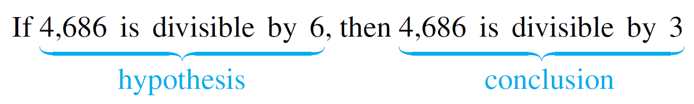
Conditional Statements
Let p and q be statements. A sentence of the form “If p then q” is denoted symbolically by “p → q”; p is called the hypothesis and q is called the conclusion. For instance,
consider the following statement:
Such a sentence is called conditional because the truth of statement q is conditioned on the truth of statement p.

Slide 4
Conditional Statements
The notation p → q indicates that → is a connective,
like ∧ or ∨, that can be used to join statements to create new statements.
To define p → q as a statement, therefore, we must specify the truth values for p → q as we specified truth values for
p ∧ q and for p ∨ q.
As is the case with the other connectives, the formal definition of truth values for →(if-then) is based on its everyday, intuitive meaning.

Slide 5
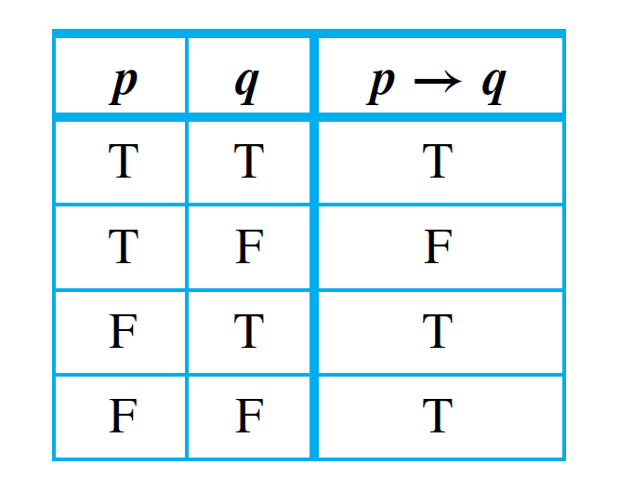
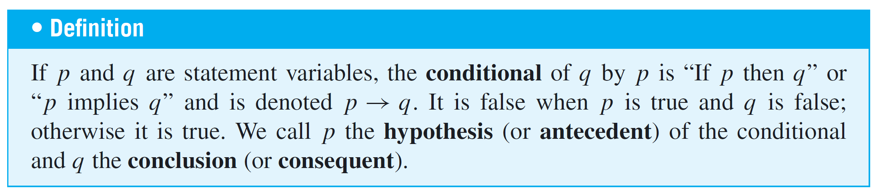
Conditional Statements
Truth Table for p ↔ q

Slide 6
Conditional Statements
A conditional statement that is true by virtue of the fact that its hypothesis is false is often called vacuously true or true by default.
Thus the statement “If you show up for work Monday morning, then you will get the job” is vacuously true if you do not show up for work Monday morning.
In general, when the “if” part of an if-then statement is false, the statement as a whole is said to be true, regardless of whether the conclusion is true or false.

Slide 7
Example 1 – A Conditional Statement with a False Hypothesis
Consider the statement:
If 0 = 1 then 1 = 2.
As strange as it may seem, since the hypothesis of this statement is false, the statement as a whole is true.

Slide 8
Conditional Statements
In expressions that include → as well as other logical operators such as ∧, ∨, and ∼, the order of operations is that → is performed last.
Thus, according to the specification of order of operations, ∼ is performed first, then ∧ and ∨, and finally →.

Slide 9
Example 2 – Truth Table for p ∨ ∼ q → ∼p
Construct a truth table for the statement form p ∨ ∼q → ∼p.
Solution:
By the order of operations given above, the following two expressions are equivalent: p ∨ ∼q → ∼p and (p ∨ (∼q)) → (∼p), and this order governs the construction of the truth table.
First fill in the four possible combinations of truth values for p and q, and then enter the truth values for ∼p and ∼q using the definition of negation.

Slide 10
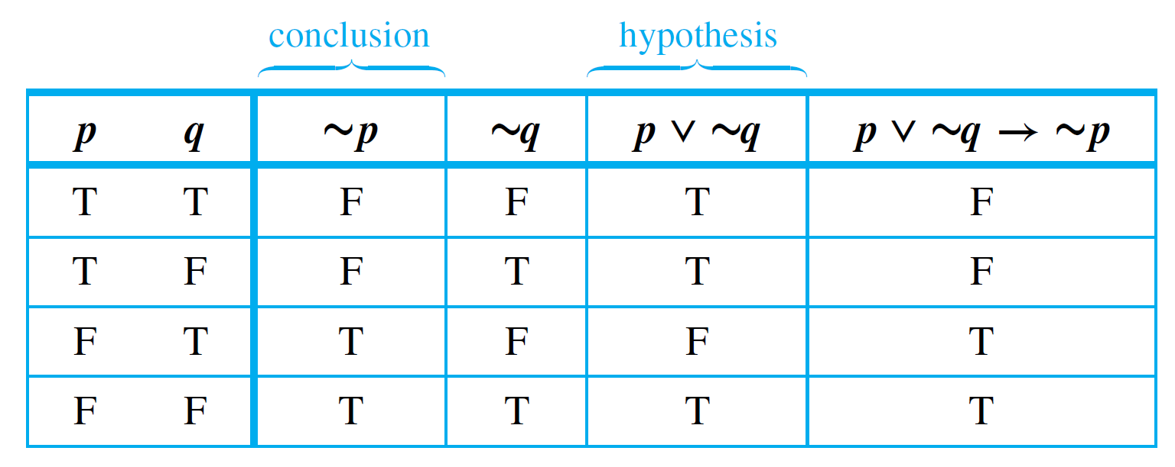
Example 2 – Solution
cont’d
Next fill in the p ∨ ∼q column using the definition of ∨. Finally, fill in the p ∨ ∼q → ∼p column using the definition
of →.
The only rows in which the hypothesis p ∨ ∼q is true and the conclusion ∼p is false are the first and second rows.
So you put F’s in those two rows and T’s in the other two rows.

Slide 11
Logical Equivalences Involving →

Slide 12
Example 3 – Division into Cases: Showing that p ∨ q → r ≡ ( p → r) ∧ (q → r)
Use truth tables to show the logical equivalence of the statement forms p ∨ q → r and (p → r ) ∧ (q → r). Annotate the table with a sentence of explanation.
Solution:
First fill in the eight possible combinations of truth values for p, q, and r.
Then fill in the columns for p ∨ q, p → r , and q → r using the definitions of or and if-then.

Slide 13
Example 3 – Solution
cont’d
For instance, the p → r column has F’s in the second and fourth rows because these are the rows in which p is true and q is false.
Next fill in the p ∨ q → r column using the definition of if-then. The rows in which the hypothesis p ∨ q is true and the conclusion r is false are the second, fourth, and sixth.
So F’s go in these rows and T’s in all the others.

Slide 14
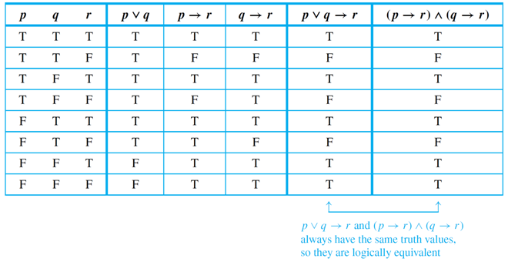
Example 3 – Solution
cont’d
The complete table shows that p ∨ q → r and (p → r) ∧ (q → r) have the same truth values for each combination of truth values of p, q, and r. Hence the two statement forms are logically equivalent.

Slide 15
Representation of If-Then As Or

Slide 16
Example 4 – Application of the Equivalence between ∼ p ∨ q and p → q
Rewrite the following statement in if-then form.
Either you get to work on time or you are fired.
Solution:
Let ∼p be
You get to work on time.
and q be
You are fired.
Then the given statement is ∼p ∨ q. Also p is
You do not get to work on time.
So the equivalent if-then version, p → q, is
If you do not get to work on time, then you are fired.

Slide 17
The Negation of a Conditional Statement

Slide 18
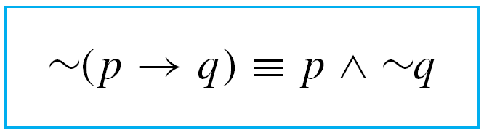
The Negation of a Conditional Statement
By definition, p → q is false if, and only if, its hypothesis, p, is true and its conclusion, q, is false. It follows that
This can be restated symbolically as follows:

Slide 19
Example 5 – Negations of If-Then Statements
Write negations for each of the following statements:
a. If my car is in the repair shop, then I cannot get to class.
b. If Sara lives in Athens, then she lives in Greece.
Solution:
a. My car is in the repair shop and I can get to class.
b. Sara lives in Athens and she does not live in Greece. (Sara might live in Athens, Georgia; Athens, Ohio; or Athens, Wisconsin.)

Slide 20
The Contrapositive of a Conditional Statement

Slide 21
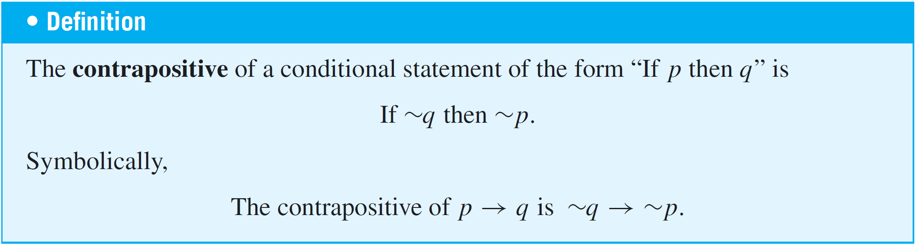
The Contrapositive of a Conditional Statement
One of the most fundamental laws of logic is the equivalence between a conditional statement and its contrapositive.
The fact is that

Slide 22
Example 6 – Writing the Contrapositive
Write each of the following statements in its equivalent contrapositive form:
a. If Howard can swim across the lake, then Howard can swim to the island.
b. If today is Easter, then tomorrow is Monday.
Solution:
a. If Howard cannot swim to the island, then Howard
cannot swim across the lake.
b. If tomorrow is not Monday, then today is not Easter.

Slide 23
The Converse and Inverse of
a Conditional Statement

Slide 24
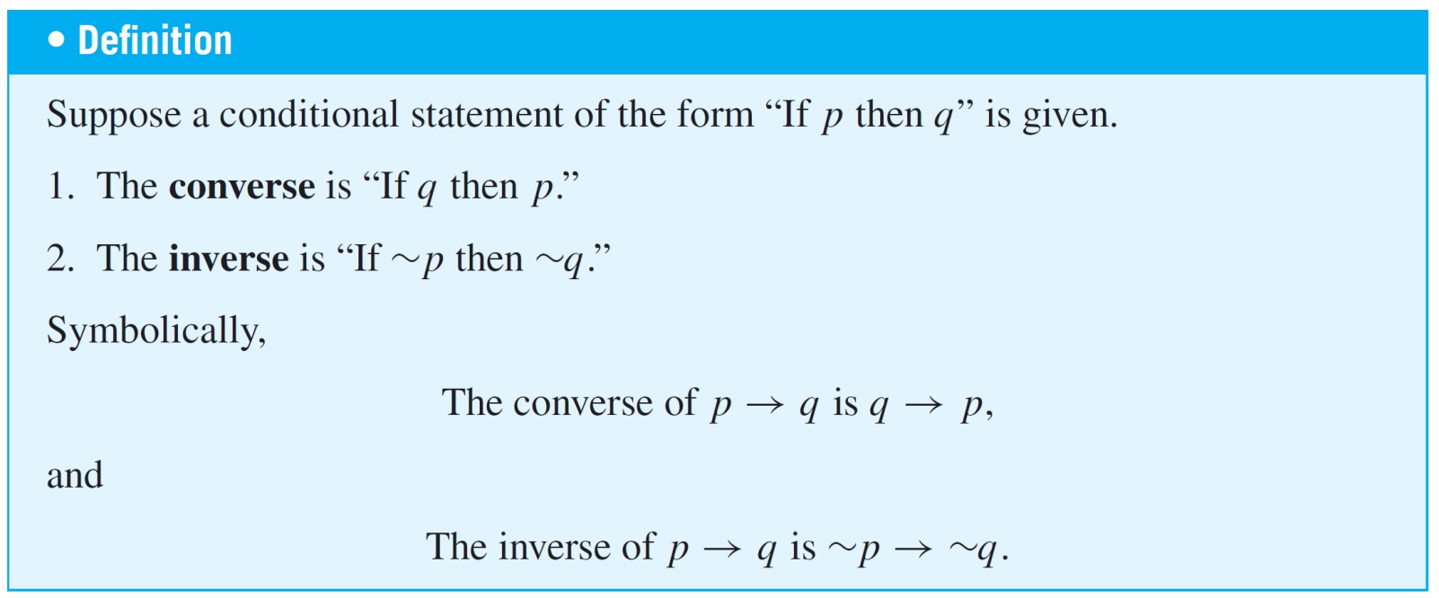
The Converse and Inverse of a Conditional Statement
The fact that a conditional statement and its contrapositive are logically equivalent is very important and has wide application. Two other variants of a conditional statement are not logically equivalent to the statement.

Slide 25
Example 7 – Writing the Converse and the Inverse
Write the converse and inverse of each of the following statements:
a. If Howard can swim across the lake, then Howard can
swim to the island.
b. If today is Easter, then tomorrow is Monday.
Solution:
a. Converse: If Howard can swim to the island, then
Howard can swim across the lake.
Inverse: If Howard cannot swim across the lake, then
Howard cannot swim to the island.

Slide 26
Example 7 – Solution
cont’d
b. Converse: If tomorrow is Monday, then today is Easter.
Inverse: If today is not Easter, then tomorrow is not
Monday.

Slide 27
The Converse and Inverse of a Conditional Statement
1. A conditional statement and its converse are not logically equivalent.
2. A conditional statement and its inverse are not logically
equivalent.
3. The converse and the inverse of a conditional statement are logically equivalent to each other.

Slide 28
Only If and the Biconditional

Slide 29
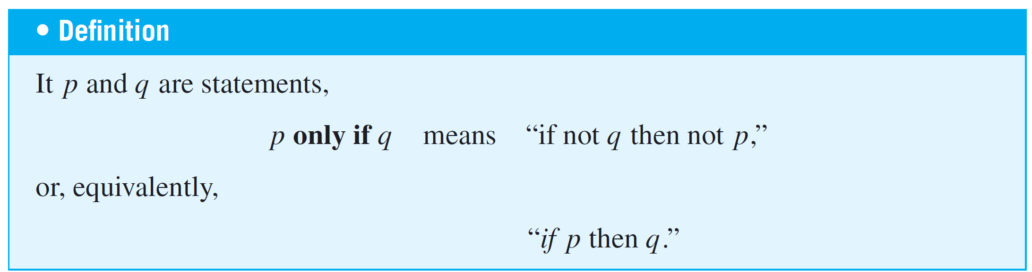
Only If and the Biconditional
To say “p only if q” means that p can take place only if q takes place also. That is, if q does not take place, then p cannot take place.
Another way to say this is that if p occurs, then q must also occur (by the logical equivalence between a statement and its contrapositive).

Slide 30
Example 8 – Converting Only If to If-Then
Rewrite the following statement in if-then form in two ways, one of which is the contrapositive of the other.
John will break the world’s record for the mile run
only if he runs the mile in under four minutes.
Solution:
Version 1: If John does not run the mile in under four
minutes, then he will not break the world’s
record.
Version 2: If John breaks the world’s record, then he will
have run the mile in under four minutes.

Slide 31
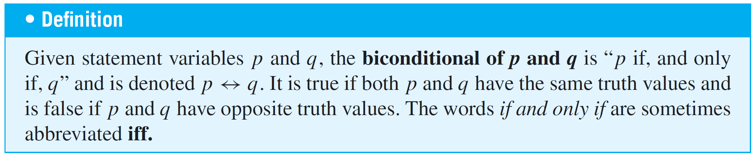
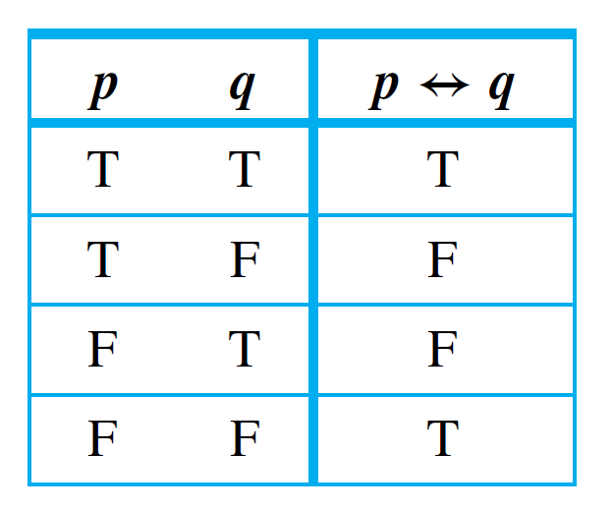
Only If and the Biconditional
The biconditional has the following truth table:
Truth Table for p ↔ q

Slide 32
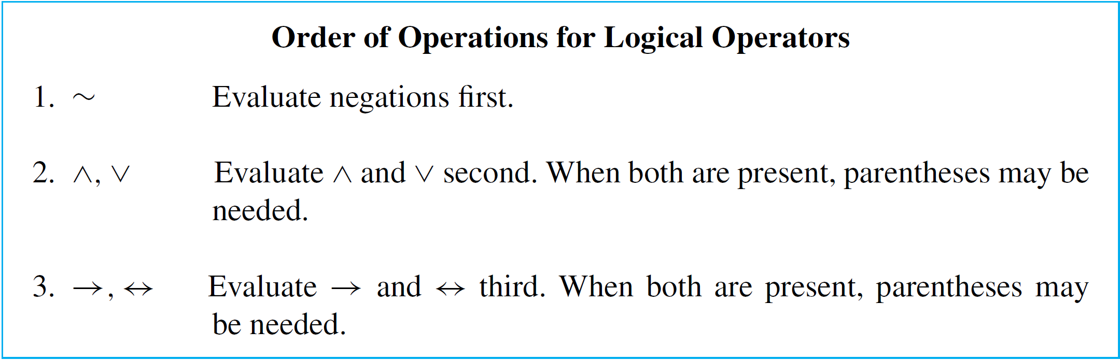
Only If and the Biconditional
In order of operations ↔ is coequal with →. As with ∧ and ∨, the only way to indicate precedence between them is to use parentheses.
The full hierarchy of operations for the five logical operators is:

Slide 33
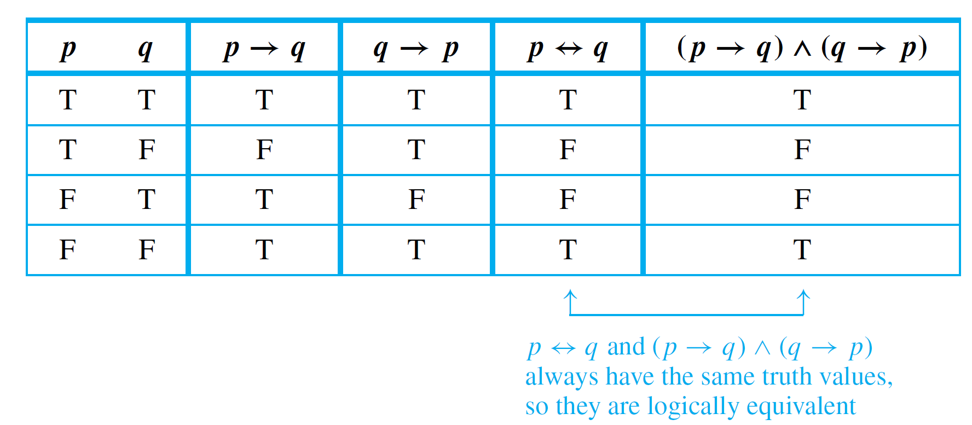
Only If and the Biconditional
According to the separate definitions of if and only if, saying “p if, and only if, q” should mean the same as saying both “p if q” and “p only if q.”
The following annotated truth table shows that this is the case:
Truth Table Showing that p ↔ q ≡ (p → q) ∧ (q → p)

Slide 34
Example 9 – If and Only If
Rewrite the following statement as a conjunction of two if-then statements:
This computer program is correct if, and only if, it produces correct answers for all possible sets of input data.
Solution:
If this program is correct, then it produces the correct answers for all possible sets of input data; and if this program produces the correct answers for all possible sets of input data, then it is correct.

Slide 35
Necessary and Sufficient Conditions

Slide 36
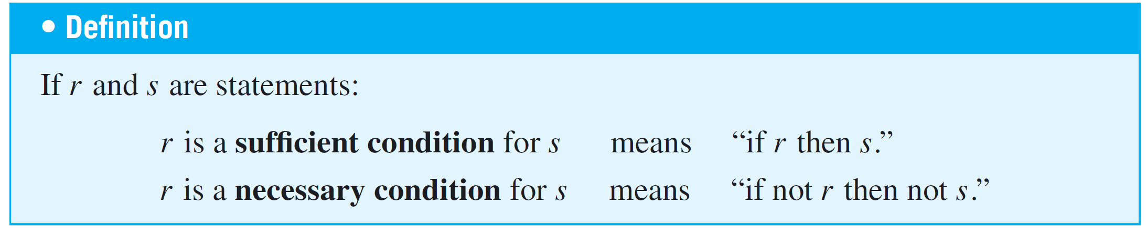
Necessary and Sufficient Conditions
The phrases necessary condition and sufficient condition, as used in formal English, correspond exactly to their definitions in logic.
In other words, to say “r is a sufficient condition for s” means that the occurrence of r is sufficient to guarantee the occurrence of s.

Slide 37
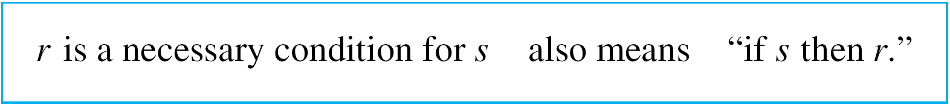
Necessary and Sufficient Conditions
On the other hand, to say “r is a necessary condition for s” means that if r does not occur, then s cannot occur either:
The occurrence of r is necessary to obtain the occurrence of s. Note that because of the equivalence between a statement and its contrapositive,
Consequently,

Slide 38
Example 10 – Interpreting Necessary and Sufficient Conditions
Consider the statement “If John is eligible to vote, then he is at least 18 years old.”
The truth of the condition “John is eligible to vote” is sufficient to ensure the truth of the condition “John is at least 18 years old.”
In addition, the condition “John is at least 18 years old” is necessary for the condition “John is eligible to vote” to be true.
If John were younger than 18, then he would not be eligible to vote.

